Slide 1
Extra Material for P1W2D3

Slide 2
P1 W2 D3 AM

Slide 3

CRISP-DM (CRoss Industry Standard Process for Data Mining)
Notes:
Sumber :
https://www.datascience-pm.com/crisp-dm-2/
https://www.datascience-pm.com/domino-data-science-life-cycle/

Slide 4

Generalization vs Overfitting - Example
Sumber : https://bulletin-cyberbully-detection.herokuapp.com/
Notes:
Sumber :
https://bulletin-cyberbully-detection.herokuapp.com/

Slide 5
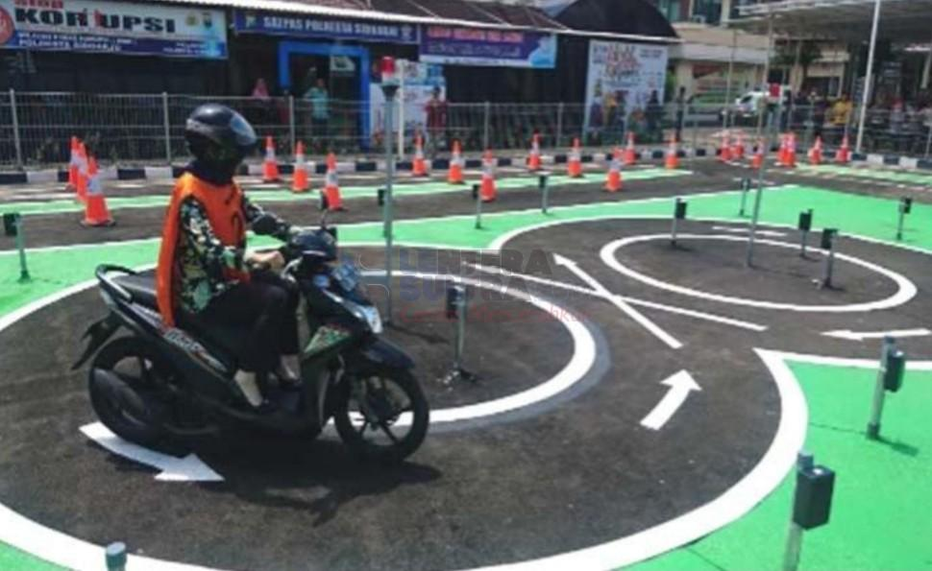
Overfitting on the Test-Set
Analogi : Ujian Praktek SIM C di Indonesia
Notes:
Sumber :
https://lenterasultra.com/wp-content/uploads/2019/09/20190903_123104.jpg

Slide 6
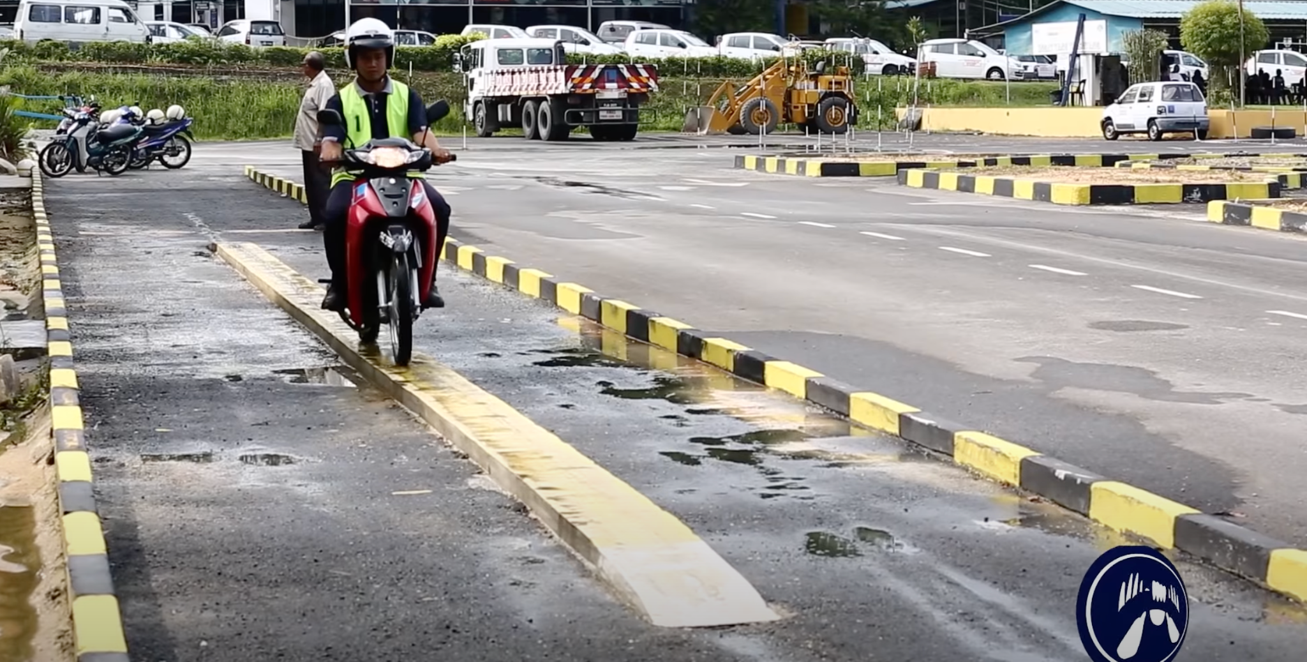
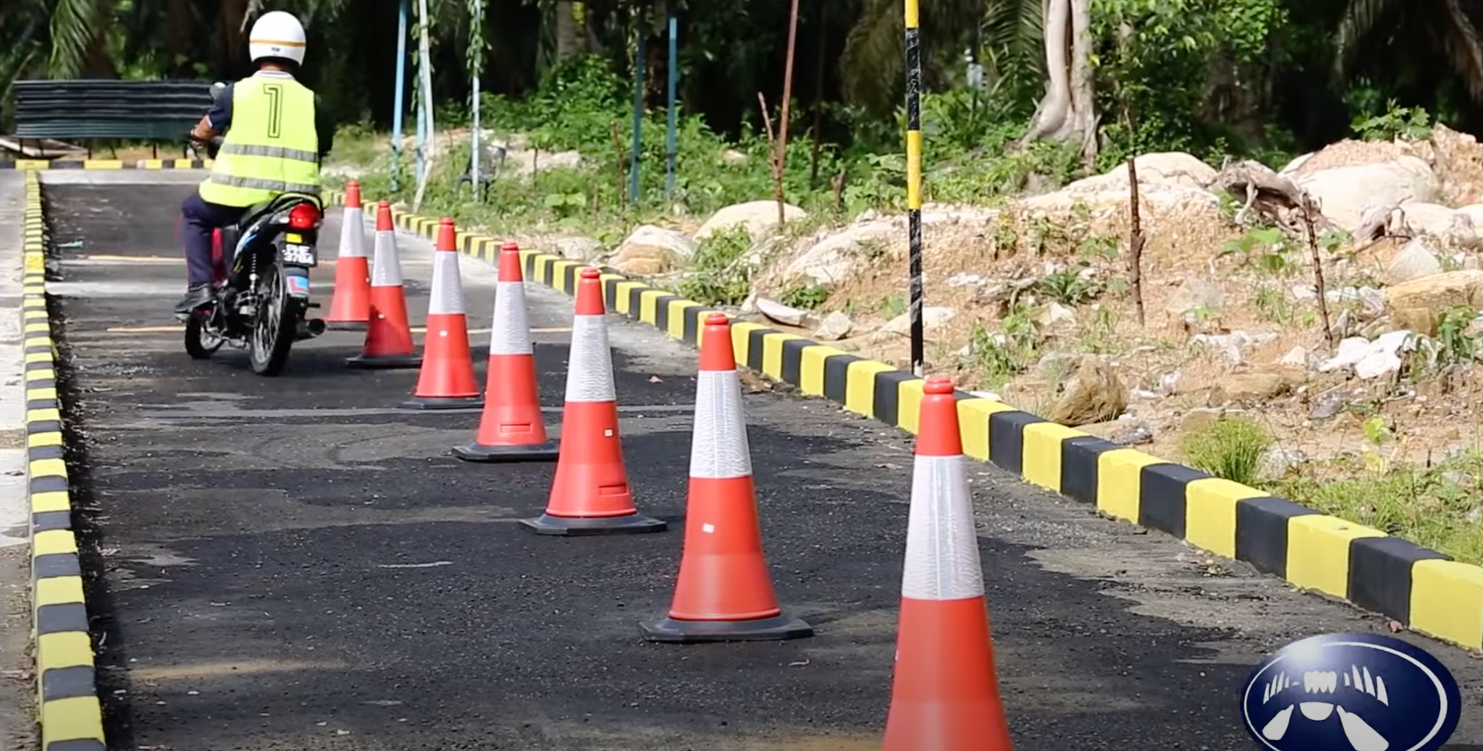
Overfitting on the Test-Set
Analogi : Ujian Praktek di Malaysia
Notes:
Sumber :
https://www.youtube.com/watch?v=z6I87Cy-M6g&ab_channel=AerialWorkz

Slide 7
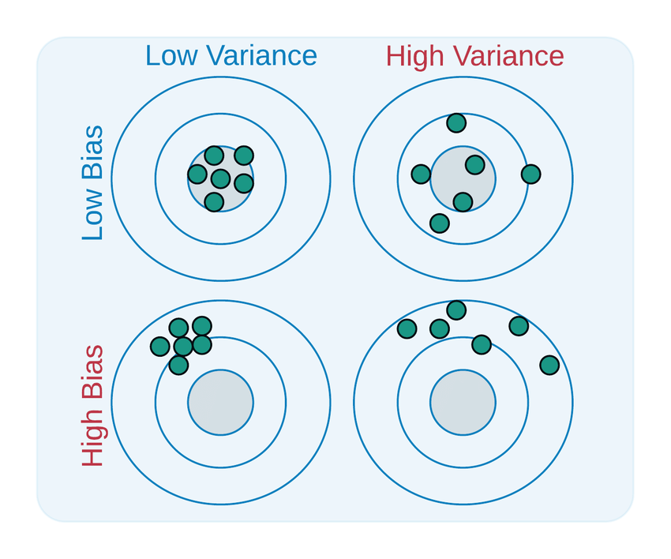
Bias vs Variance
Notes:
Sumber :
https://www.researchgate.net/profile/Junhua-Ding/publication/318432363/figure/fig3/AS:667604972761097@1536180837464/Visualizing-bias-and-variance-tradeoff-using-a-bulls-eye-diagram.ppm

Slide 8

Cross Validation
Notes:
Sumber :
https://img1.daumcdn.net/thumb/R1280x0/?scode=mtistory2&fname=https%3A%2F%2Fblog.kakaocdn.net%2Fdn%2FluuGW%2FbtrgjGrj9g6%2FNOsrBEQIr2uTRynM2PZ3h1%2Fimg.png

Slide 9
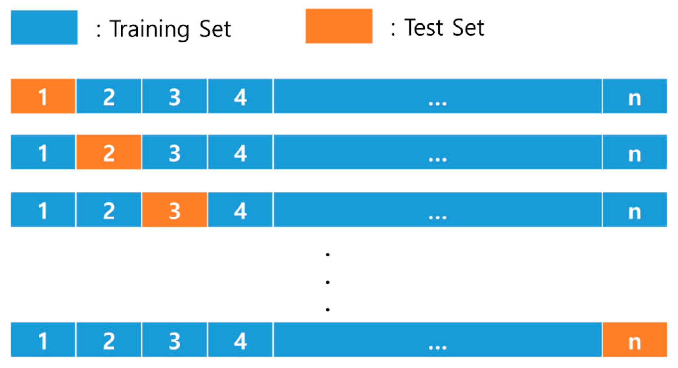
Leave One Out (LOOCV)
Notes:
Sumber :
https://www.researchgate.net/profile/Nikolaos-Chlis/publication/266617511/figure/fig11/AS:295705362092036@1447513060277/Leave-One-Out-Cross-Validation.png
https://www.mdpi.com/ijerph/ijerph-17-06997/article_deploy/html/images/ijerph-17-06997-g002.png

Slide 10
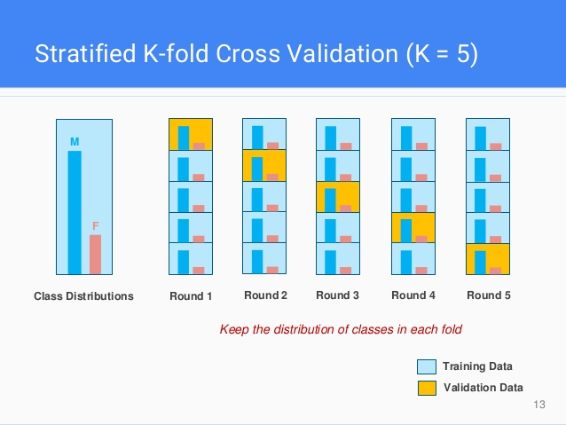
Stratified K-Fold
Notes:
Sumber :
https://www.google.com/url?sa=i&url=https%3A%2F%2Fdockship.io%2Farticles%2F6045b9c1c2c7fa59d94ed69a%2Fa-gentle-introduction-to-cross-validation&psig=AOvVaw1B3gicm63vORxjc9-CA_H1&ust=1648088093385000&source=images&cd=vfe&ved=0CAsQjRxqFwoTCPj8ld-U2_YCFQAAAAAdAAAAABAT

Slide 11
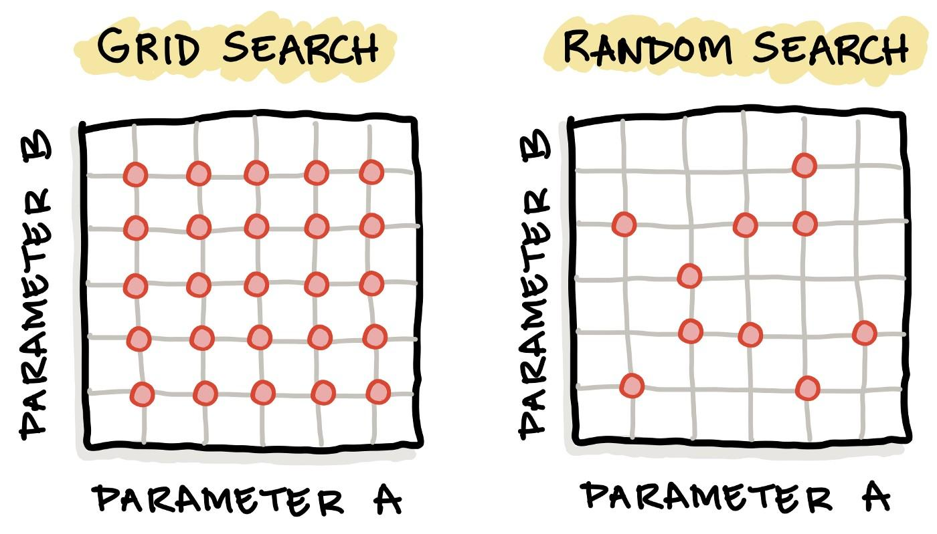
Grid Search vs Random Search
Notes:
Sumber :
https://miro.medium.com/max/1400/1*u4NoUdaVyquPZetjydZs0A.jpeg

Slide 12
P1 W2 D3 PM

Slide 13
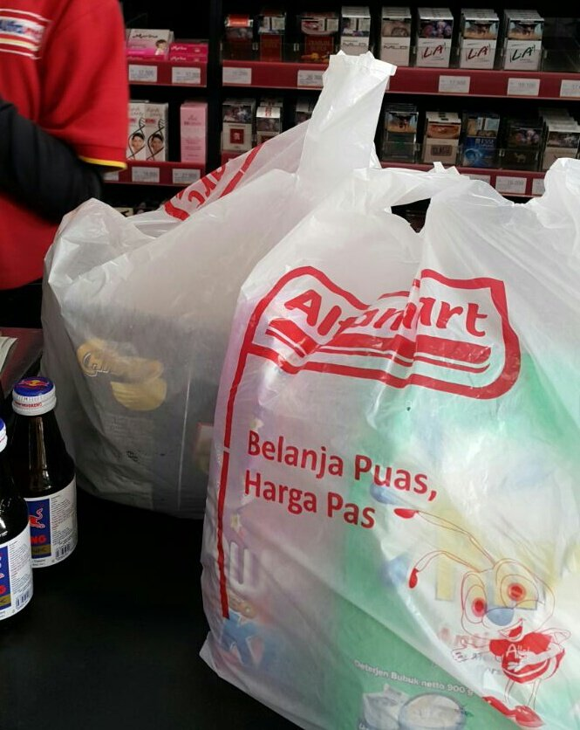
Pipeline (Illustration)
Notes:
Sumber :
https://miro.medium.com/max/1400/1*u4NoUdaVyquPZetjydZs0A.jpeg

Slide 14

GridSearch without/with Pipeline (Illustration)
GridSearch without Pipeline GridSearch with Pipeline
Notes:
Sumber :
https://miro.medium.com/max/1400/1*u4NoUdaVyquPZetjydZs0A.jpeg

